Slide 1
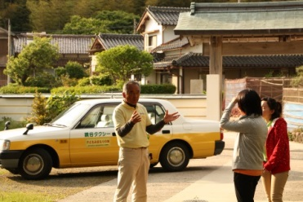
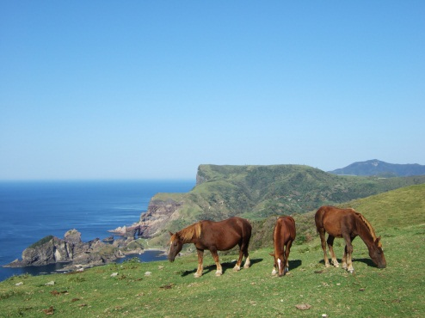
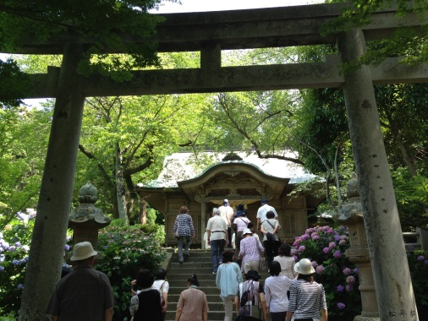
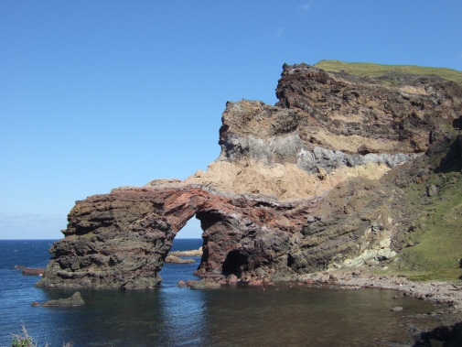
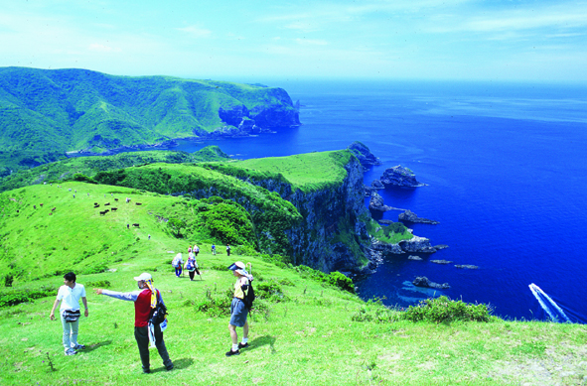
Nishinoshima Sightseeing Taxi
Course | Time | Tour Route | Jumbo (9 passengers) | Regular (4~5 passengers)
A | 1 hr | Beppu / Uragō → Akao Lookout OR Matengai Cliff OR Tsūtenkyō Arch (Kuniga Beach) → Beppu / Uragō | ８，４６０円 | ６，３６０円
B | 1.5 hr | Beppu / Uragō → Akao Lookout → Matengai Cliff OR Tsūtenkyō Arch (Kuniga Beach) → Beppu / Uragō | １２，９６０円 | ９，５４０円
C | 2 hr | Beppu / Uragō → Akao Lookout → Matengai Cliff → Tsūtenkyō Arch (Kuniga Beach) → Beppu / Uragō | １６．９２０円 | １２，７２０円
D | 2.5 hr | Beppu / Uragō → Yurahime Shrine → Akao Lookout → Matengai Cliff → Tsūtenkyō Arch (Kuniga Beach) → Beppu / Uragō | ２１，１５０円 | １５，９００円
E | 3 hr | Beppu / Uragō → Kuroki-gosho Imperial Residence Site → Yurahime Shrine → Akao Lookout → Matengai Cliff → Tsūtenkyō Arch (Kuniga Beach) → Beppu / Uragō | ２５，３８０円 | １９，０８０円
Sunset Taxi Tour | 1 hr | Beppu / Uragō → Akao Lookout OR Matengai Cliff OR Tsūtenkyō Arch (Kuniga Beach) → Beppu / Uragō | ８，４６０円 | ６，３６０円
Kagamitani Taxi 08514-7-8321 Hara Taxi 08514-6-0056
Akao Lookout Yurahime Shrine Tsūtenkyō/ Kuniga Beach Matengai

